Slide 1
INTRODUCTION TO PERMACULTURE
Urban Strategies
Workshops 2014
Butte College

Slide 2
What is perma-fun-K?
perma-fun-K is an educational non profit that offers Permaculture & Regenerative Agriculture hands-on workshops for adults and children.
It was funded in 2009
It works simultaneously in the mediterranean areas of Spain and different parts of California.

Slide 3
perma-fun-K
permanent
permaculture
learning through
fun
celebration

Slide 4
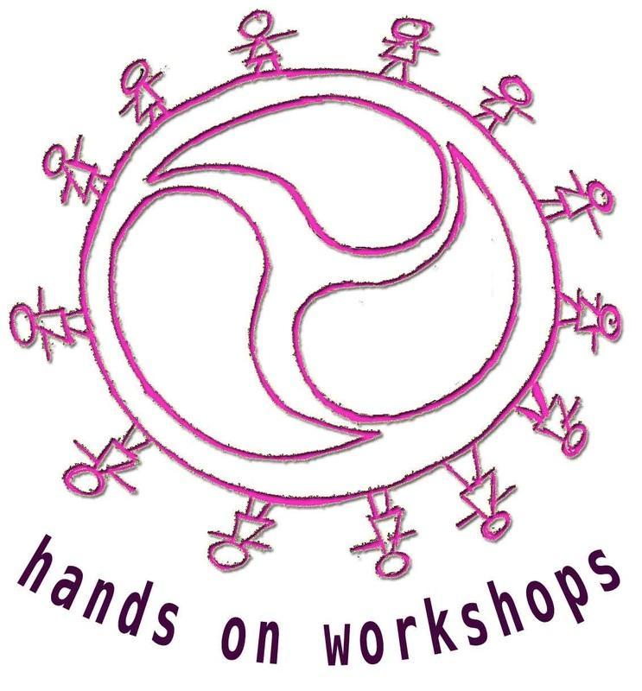
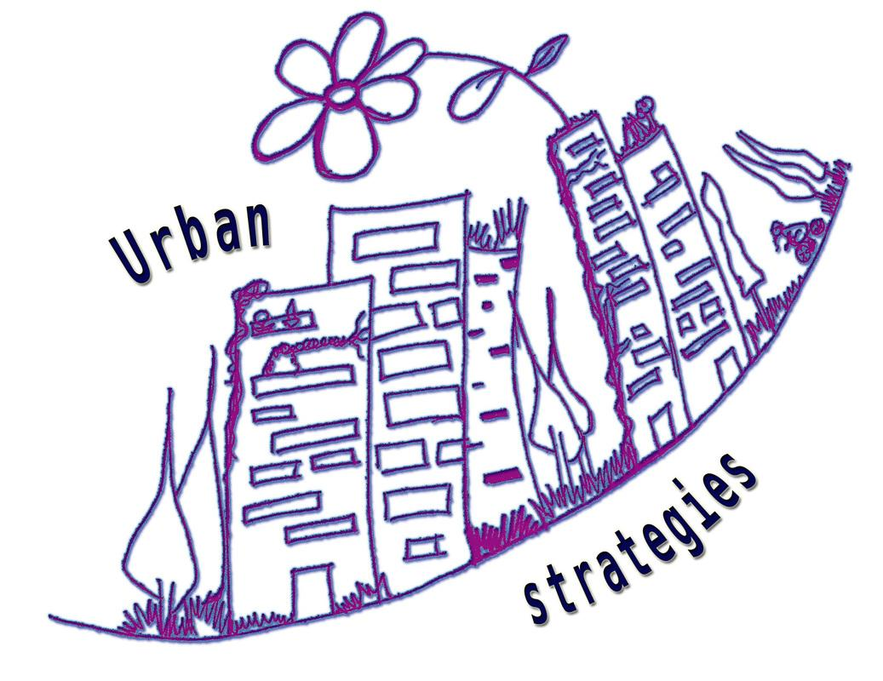
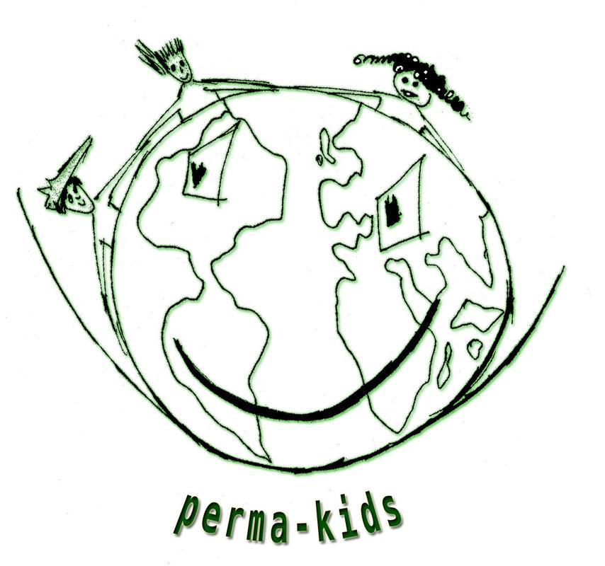
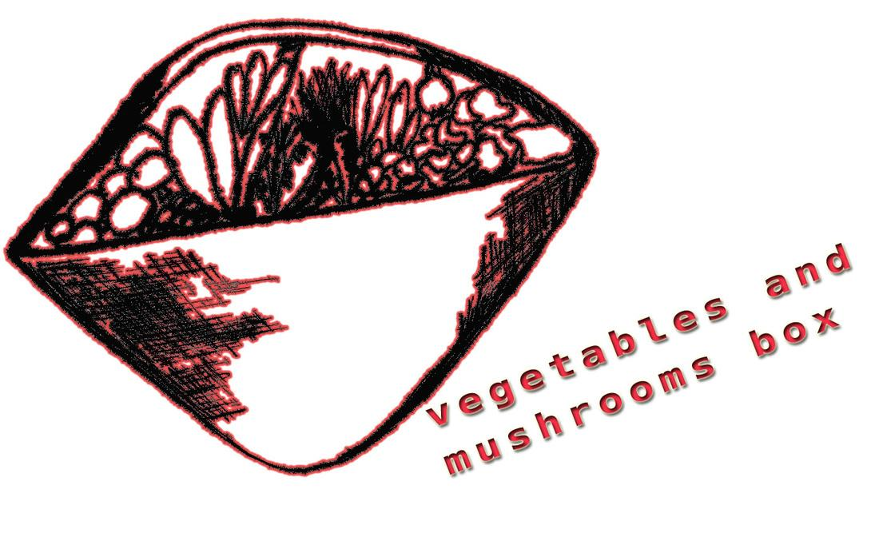
Our main focus of action
- Hands-on workshops
- Urban strategies
- Perma-kids
- Veggy box
perma-fun-K.com

Slide 5
Goals
*To promote organic &
regenerative agriculture practices.
*To create permaculture
education with other organizations..
*To move towards more resilient
habits & communities.
*To document educational
videos & materials.
Barcelona, Permaculture work day

Slide 6
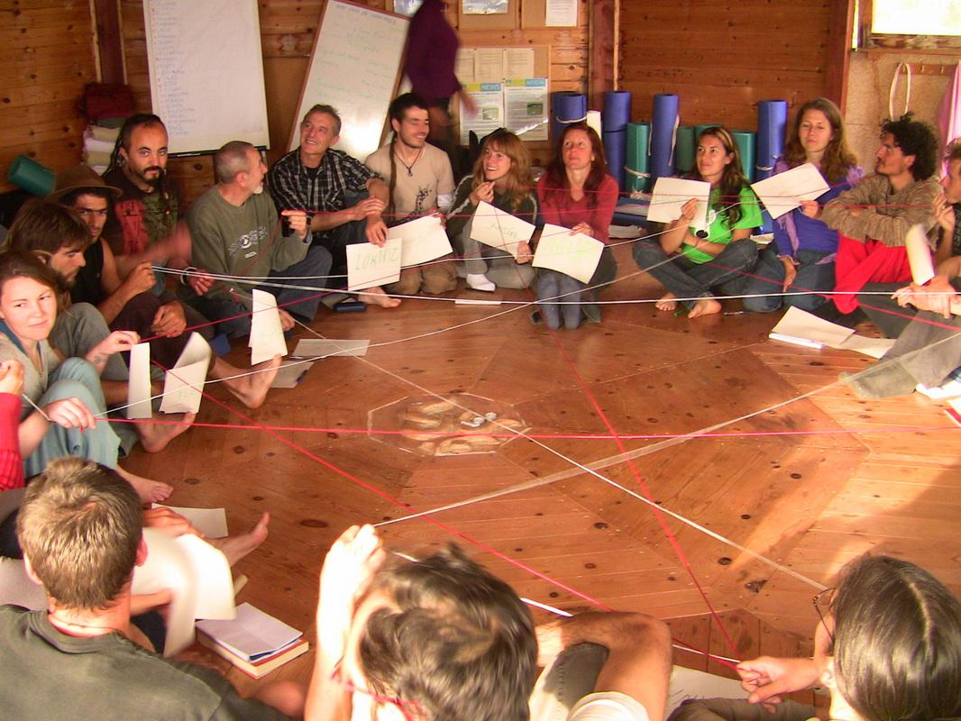
Educational approaches
-HANDS-ON LEARNING &
COMMUNITY CELEBRATION.
-Creating a safe container where coming into leadership &
problem solving is embraced
for all the participants.
-Applying eco village group
dynamics, eco psychology &
sustainable community
techniques.
Ibiza, Spain PDC

Slide 7
Workshops DVD
In this DVD you will learn:
-Introduction to Permaculture
-Introduction to Regenerative Agriculture
-Intensive gardening techniques
-Food forest
-Water catchments & grey water
-Water catchment tank building
-Biogas cooker building
-Edible mushrooms & inoculation
-hydrogen cell building
-Urban homesteading and more.
- Butte College Workshops
- Happy corner Hands-on workshops
- Grub Fall hands-on series
pre-order:
530 966 6686

Slide 8
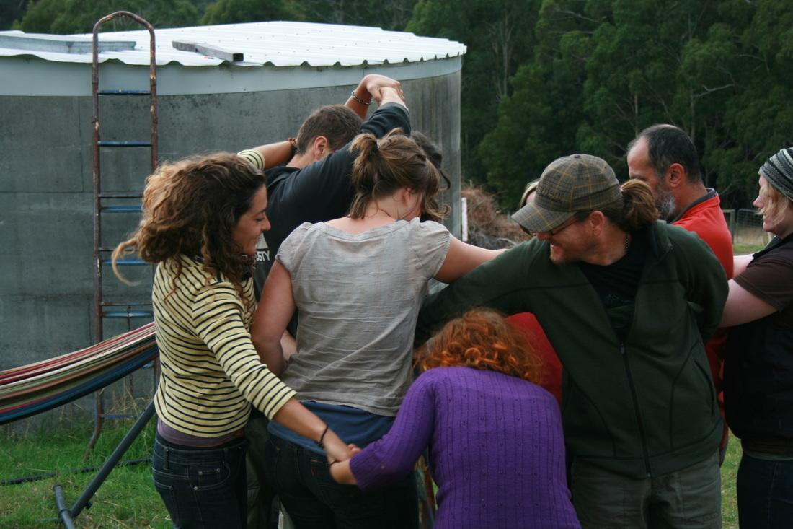
what does permaculture stand for?
PERMANENT CULTURE
PERMANENT AGRICULTURE
Tasmania PDC

Slide 9
HUG
agriculture
resilience
alternative technologies
community
regenerative techniques
education
land management
natural building
alternative economies

Slide 10
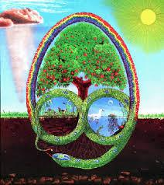
permaculture...
Its an eco design science
that uses deep observation
& applies methods &
techniques,
to mimic nature’s systems &
adapt them to our education,
economy, housing,
farming and way of living.
ITS BASED ON SOLUTION FINDING & ACTION.

Slide 11
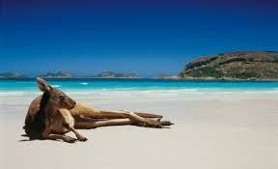
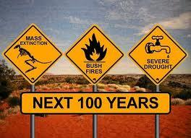
Solution finding based
Each problem holds
the solution
DEEP OBSERVATION
PATTERNS
WHOLE TO DETAILS
MIMIC NATURE SYSTEMS

Slide 12
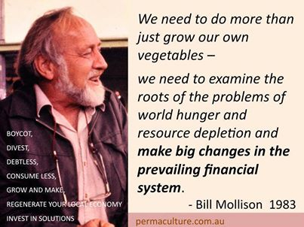
Bill Mollison

Slide 13
Forced to change
"Love is a verb.
We have to let our love call us into action."
Lierre Keith

Slide 14
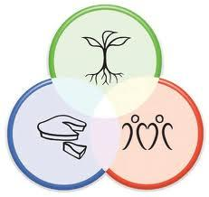
ethics
Care of the earth
Care of the people
Share

Slide 15
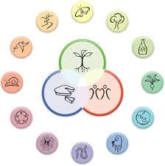
Principles
1-Observe & interact
2-Catch & store energy
3-Obtain a yield
4-Apply self regulation & accept feedback
5-Use & value renewable resources & services
6-Produce no waste
7-Design from patterns to details
8-Integrate rather than segregate
9-Use small & slow solutions
10-Use & value diversity
11-Use edges & value the marginal
12-Creatively use and respond to change

Slide 16
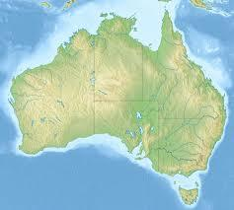
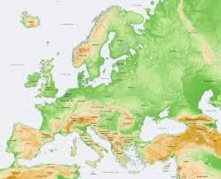
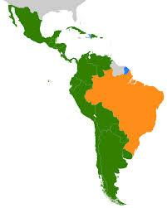
History and evolution of permaculture TIME & LOCATION
original
nature orientated
overpopulated
socially orientated
???

Slide 17
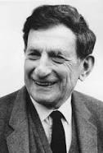
David Bohm
-We haven’t worked on ways to develop a higher social intelligence...
-We need this higher intelligence to operate socially, otherwise we are not going to survive...
-If we don’t manage things socially,
individual high intelligence is not going to make much difference…
-Thought is largely a collective phenomenon, made possible only through culture and communication.

Slide 18
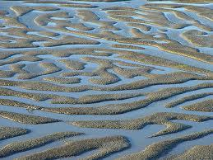
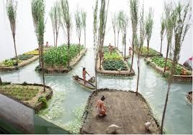
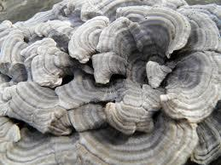
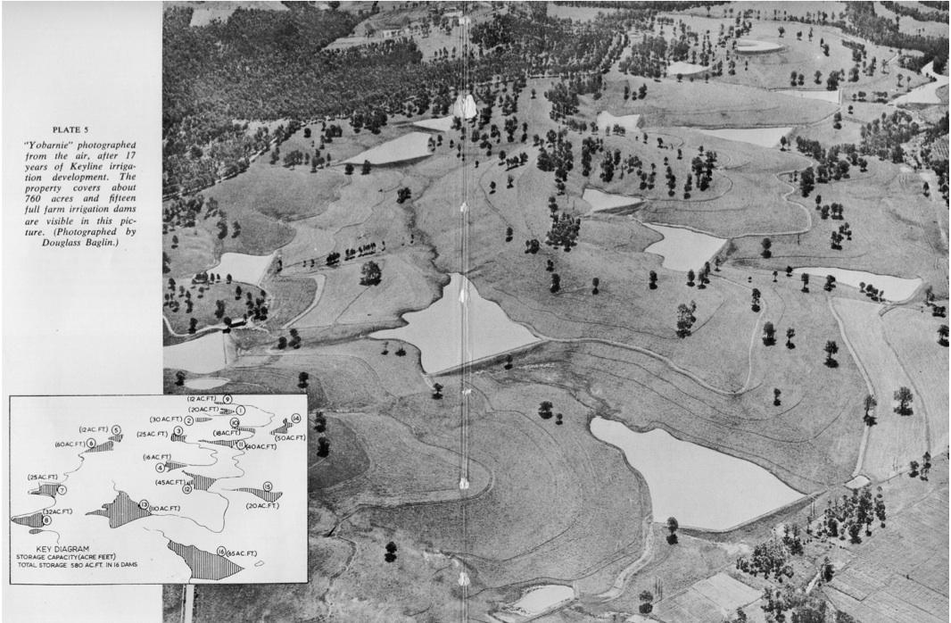
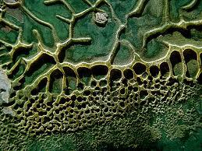
patterns
chinampas

Slide 19
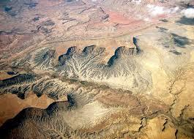
pattern to design

Slide 20
what do you see in this natural pattern?
what is it good at?
how does it work?

Slide 21
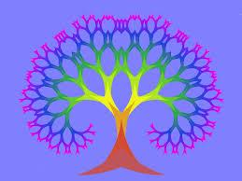
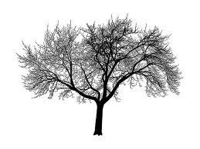
GOOD AT COLLECTING AND FLUSHING
OPTIMUM FLOW PATTERN
CATCHMENT
irrigation system
INDIVIDUALS
drainage system
GROUPS
PERMACULTURE
SYNERGY is basically
this juncture
COLLECTING COMMON
INFORMATION so that
COLLECTIVE INTELLIGENCE
can FLOW through out the
community and back
NUTRIENTS
NUTRIENDS & WATER FLOW
GAS GLOW
TRAFFIC OR INFORMATION FLOW

Slide 22
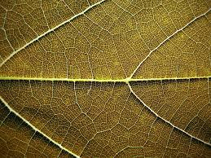
synergies
INCLUDES & TRANSCENDS THE OLD STRUCTURES ( natural way of evolution )
MAKING CONNECTIONS

Slide 23
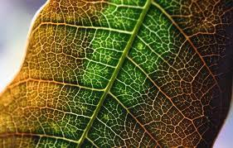
An exercise in collective intelligence

Slide 24
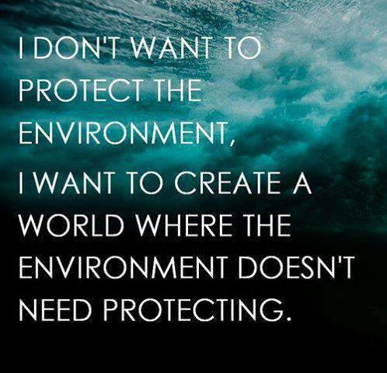
Wider vision

Slide 25
chaordic
Is the name of a natural pattern..
… is the pattern of complex natural self regulating systems..
.. like ecosystems
.. like your body
.. like your brain
.. like a forest
..so we can consciously design organizations and lifes that way too!!

Slide 26
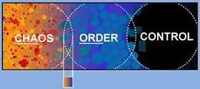
A “chaord” is
Any organization, organism or system that is:
Self organized
Self Govern
Non-linear
Adaptable
Complex
Chaos / Order

Slide 27
Thanks for your patience

